Slide 1

Melanoma Challenges
Paola N. Martinez A., Emily E. Carvajal C.
Image Processing Approach
Computer Aided Diagnosis
MAIA 2022

Slide 2
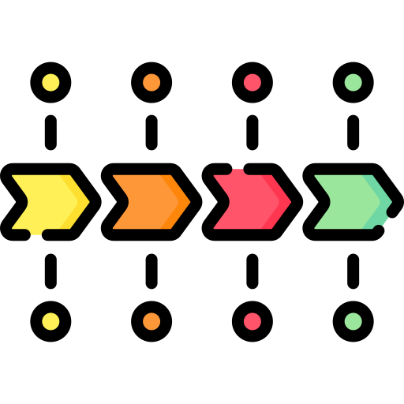
Pipelines Structures
Options
Name
Preprocessing step 1
PREPROCESSING
CLAHE
Grey world
White Balance
Hair removal
Hard Thresholding
Preprocessing step 2
Features 1
FEATURES EXTRACTION
Color
GLCM
LBP
ORB
Zernike
Features 2
ML Step 1
Recursive Feature Elimination (RFE)
Select From Model
Mutual Information
Standard Scaler
Imbalance Strategies
MACHINE LEARNING
ML Step 2
Classifiers
Notes:
Possible steps used for every subsection of the pipeline
Challenges associated with the accurate detection of melanoma are illumination effects and the presence of noise in dermoscopic images in the form of bubbles, hair, etc.

Slide 3

Why not segmentation methods?
Taking into account:
Recommendation of the professors about simplicity
A paper we found (Mahbod A. et al 2020)
We try and it was giving volatile results
However…
In the preprocessing steps with Hard Thresholding we try to tackle the Vignette Problem
Notes:
We decide to not segment the moles do to the reasons listed above.
We also propose the Hard Thresholding method that will be explained in the slide 6.

Slide 4
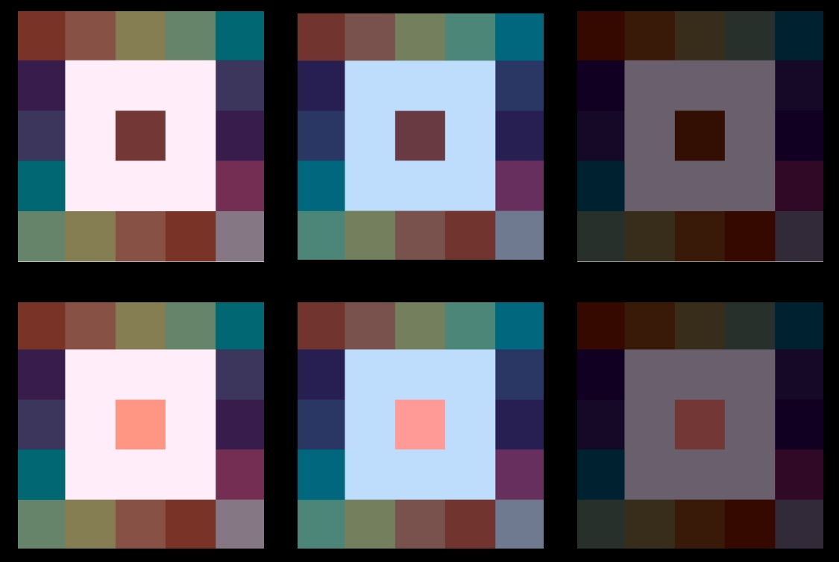
Preprocessing: Color Constancy
Gray World (Barata, C., et al 2014)
Proposed by Buchsbaum in 1980. It estimates the illuminant using the pixels average color and it assumes that your scene, on average, is a neutral gray (Buchsbaum, G et al 1980)
We estimate illumination color using average color and comparing it to gray
It holds if we have a good distribution of colors in the image.
Works well if we have just one illumination source.
White Balance (Dongliang Cheng, 2015)
Works by applying different gains to the input image channels
Method that predict chromaticity of the illumination in the images base on some simple features
Notes:
from Barata et al 2014 we know color constancy improve the classification of dermatoscopic images from different sources. Which is our case given the mixture of conditions of the images (datasets)
It’s also worth mentioning from the paper that color constancy strategies improve color features derived from other color spaces and also can be applied to texture features.

Slide 5
Preprocessing: Hair Removal
Hair removal based on Black Hat method morphological operation
Hair removal with eight (8) linear structural elements and black hat morphological operation
Hair removal with four (4) linear structural elements instead of eight (8)
Notes:
Hair removal is a common preprocessing step for dermatoscopic images as it can occlude the ROI. We test a hair removal method base on black hat. A variation suggested by professor bria during the past semester
and a version of the previous with less angles for the linear structural element that lead to a less computationally costly step. After a qualitative analysis of a subset of images we decide to use the third option.

Slide 6
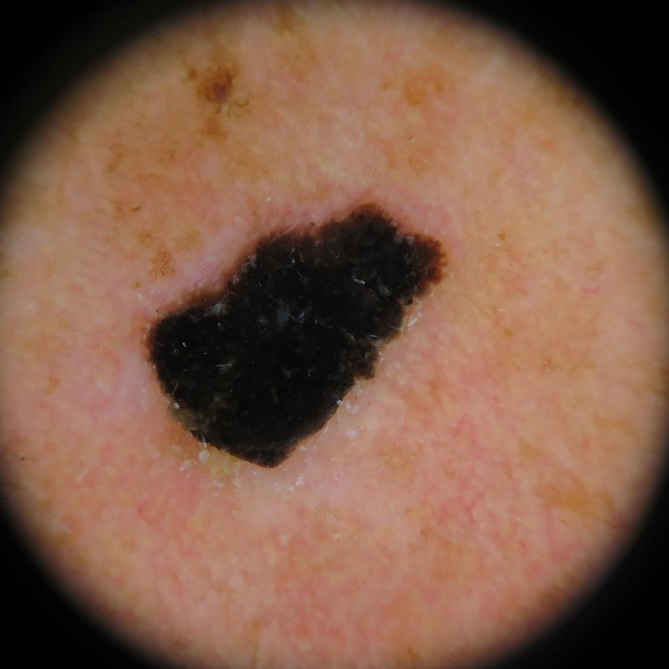
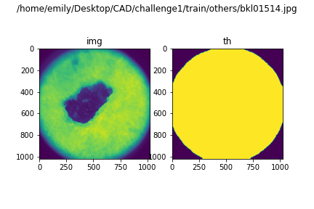
Preprocessing: Hard Thresholding
Steps:
Perform a low threshold (60)
Draw a center window of 1/2 of the image size
Perform connected components
Check if the component fulfil:
bounding box is partially within the center window
bounding box not near (~50p) an edge
If true, the component is discarded
Return: Vignette mask
for prop in props:
# checking conditions of
# position and limits
end
Notes:
This method is a proposal for the vignette problem present in the dermatoscopic images.
IT was taylor to detect the black corners with a low threshold.
We take into account the fact that the images are center in the mole and draw a window in the center of the image to use as reference.
By performing the connected components we expect to discard the one that catch the mole. This by using spatial information
Discarding them if the bounding box intersects with the center and is not near a limit (with a margin of 50 pixels ) of the image.
We test this method on 300 images from the training set of the challenge 1 where just one of the return bad results. and 5 where affected by illumination problems.

Slide 7
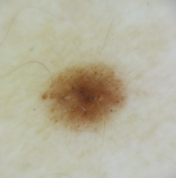
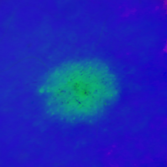
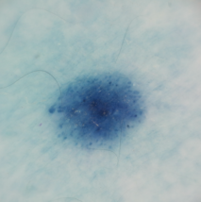
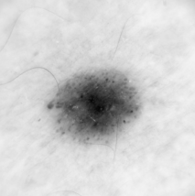
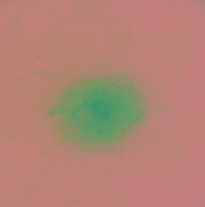
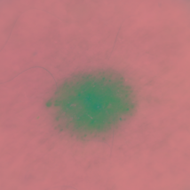
Features: Color
Original
HSV
BGR
Mean
Standard Deviation
For each: compute
Skewness
Kurtosis
Grayscale
YCbCr
LAB
Notes:
We had 52 features from Color. Features were extracted from each channel (3) on 5 different spaces: HSV, BGR, YCbCr, Lab and Grayscale (1 channel).

Slide 8
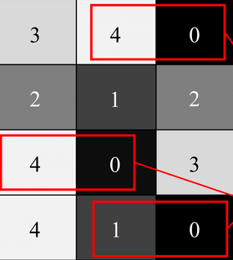
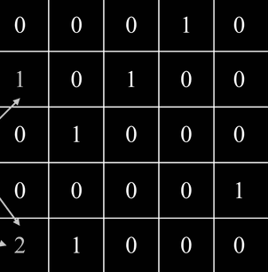

Features: Texture
GLCM
LBP
Notes:
GLCM was used with distance 1, and angles 0, 45, 90 and 135.
LBP was obtained with 8 points and radius 1.

Slide 9
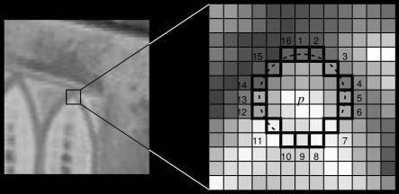
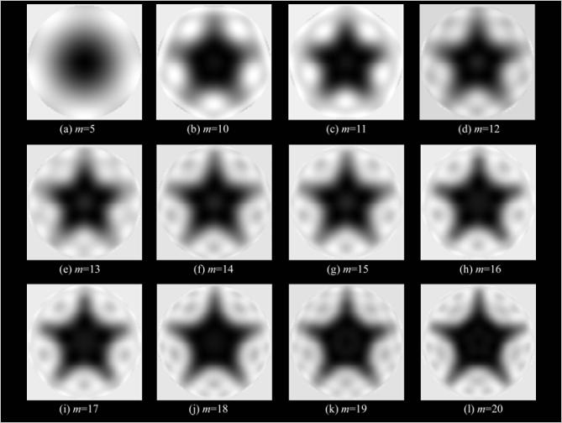
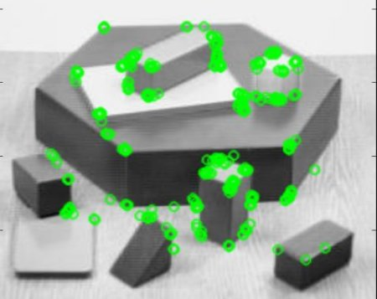
Features
ORB
Zernike
Notes:
With ORB we obtained 64 keypoints, each one with its vector descriptor of 32 values.
For Zernike, we used 25 moments with degree 8, and radius 200 (based on the images size that we had)

Slide 10
Pipelines tested

Slide 11
Pipelines
A
B
C
D
E
F
G
CLAHE
CLAHE
CLAHE
CLAHE
Hair removal
White Balance
Grey world
White Balance
Hair removal
Hair removal
Hair removal
CLAHE
Hair removal
Hair removal
Hair removal
Hard thresholding
Color
Color
Color
Color
Color
Color
GLCM
GLCM
GLCM
GLCM
GLCM
GLCM
Color
LBP
LBP
LBP
LBP
LBP
LBP
ORB
Zernike
Standard
Scaler
Zernike
Standard
Scaler
Standard
Scaler
Standard
Scaler
Standard
Scaler
RFE
RFE
Standard
Scaler
RFE
RFE
RFE
Classifiers
Standard
Scaler
Classifiers
RFE
Classifiers
Classifiers
Classifiers
RFE
Classifiers
Classifiers
Notes:
pipeline A - will not present further results because we have issues during the implementation parts. That’s why we start to use white balance instead of gray world for illumination correction
Pipeline G - was tested with just color features therefore do not appear in the graphs as it is not comparable. It gave results between 61-65 f1 score making it not close to the top performers
Pipeline B and C are a variation for the preprocessing steps
Pipeline E - the simplest and one of the first approach tested before trying to enhance the image

Slide 12

ML Balancing Strategies
Oversampling
All the classes augment to the one with more samples
The minority class(es) augment to the one with more samples
The classes augment in a given percentage (Fixed)
UnderSampling
All the classes reduce to the size of the minimum class
The classes reduce in a given percentage
Combined
Undersampling + Oversampling, each with a given percentage
Undersampling + Oversampling with a library and no instructions for balancing the classes
from imblearn.over_sampling import SMOTE
Notes:
For Balancing Strategies, SMOTE library was used along with SMOTEEN.

Slide 13

Classifiers
Random Forest (RF)
Decision Tree
Support Vector Machine
AdaBoost
Grad Boost
HistGradBoost
XG Boost
K-Nearest Neighbors
Linear Discriminant Analysis (LDA)
MultiLayer Perceptron (MLP)
For most of the classifiers a hyperparameters optimization was perform with a 5-Fold cross validation.

Slide 14
Results

Slide 15
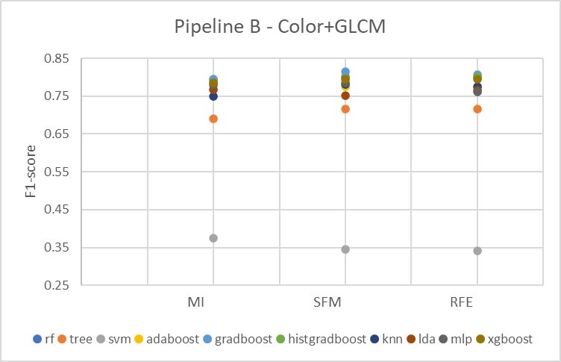
ML Preprocessing
Feature Selection
MI: Mutual Information
SFM: Select From Model
RFE: Recursive Feature Elimination
Notes:
Standard scaler was performed in every pipeline.
Top results are with RFE and SFM. RFE was more consisting, so we chose it.

Slide 16
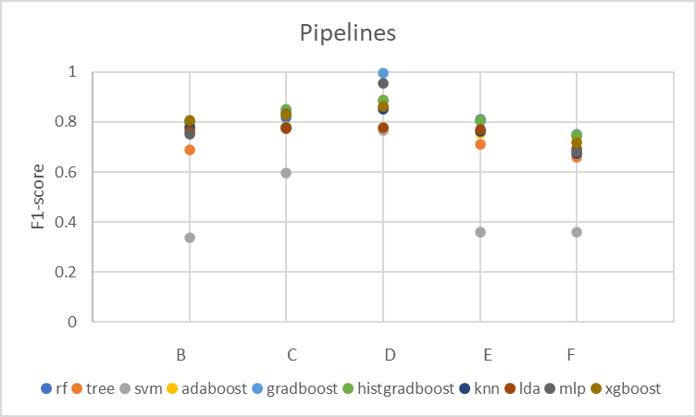
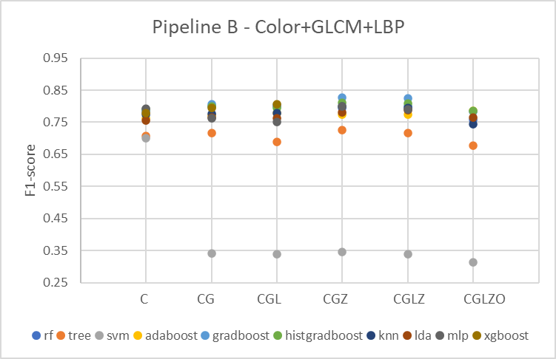
Results - Binary Classification
Pipelines using Color+GLCM+LBP
Pipelines of features combination
Final chosen pipeline
C: Color G: GLCM L: LBP
Z: Zernike O: ORB
Notes:
First - right plot - results of different combinations for the features generated were we can see CGZ and CGLZ have the best results. Nonetheless, Pipeline D showed best results with CGL, so we decided to continue with it for more experimentation.
Second - left plot - is the results of pipelines B to F with Color, GLCM and LBP. Best performance reaching one for the pipeline D. However with the suspicion of overfitting decide to go with the Random Forest Classifier with 89 for the f1 score

Slide 17
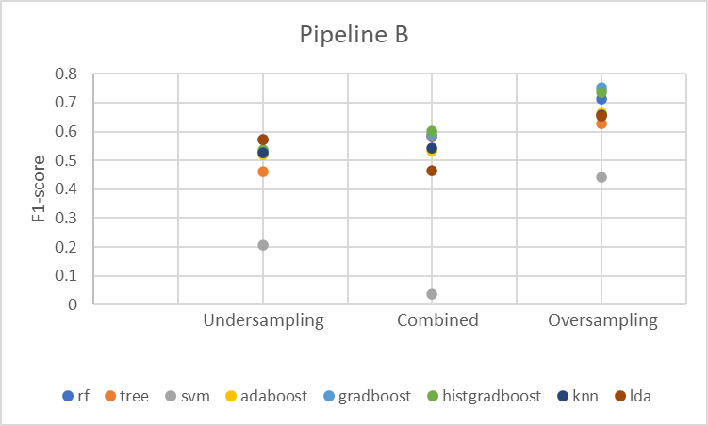
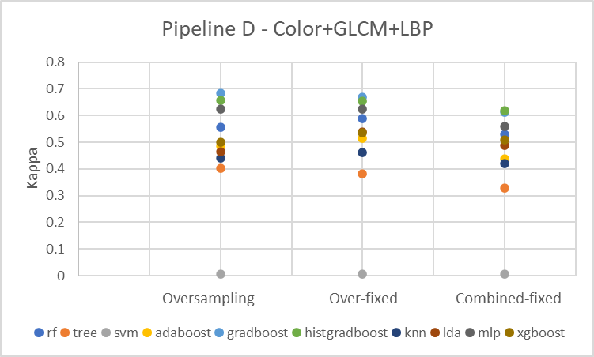
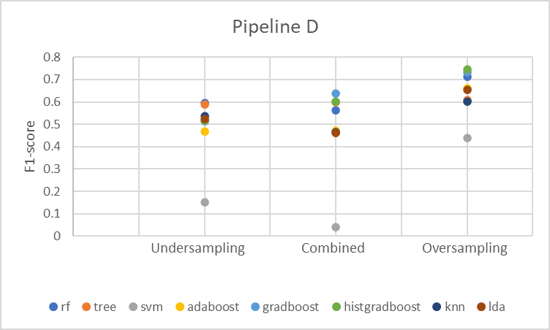
Results - Multiclass Classification
Final Results
Final chosen pipeline
Notes:
left - top and bottom charts - pipeline B and D were compared using just the features for Color here oversampling works better
right - We made tests with some oversampling techniques: oversample all the classes to the majority, oversampling just the minority fixing the amount, and combining undersampling and then oversampling. The chosen one is Over-fixed

Slide 18
Conclusions
Pipeline D: CLAHE + White balance + Hair removal for the feature extraction process return the best results. Closely follow by Pipelines C and E
A simpler approach lead to good results. No segmentation or enhancement is made to Pipeline E and have one of the best results
Understand why the Hard Thresholding approach worsen the results requires further experimentation
The combination between color and texture features gave the best results
Managing unbalanced datasets can be challenging and it is difficult to know the right amount of synthetic data that can help the classifier without overfitting.
Zernike moments as a shape feature gave good results, but in Pipeline D, the combination between Color+GLCM+LBP gave the best outcome.
The combination between all extracted features does not always give the best result.
Given the amount of features created the curse of dimensionality have to be manage using feature selection strategies
Notes:
color + textures is the best for a pipeline with color constancy in it. as it was suggested on the paper of color constancy for dermatoscopic images it improve the results.

Slide 19
Thanks!
Questions?

Slide 20
References
Barata, C., Celebi, M. E., & Marques, J. S. (2014). Improving dermoscopy image classification using color constancy. IEEE journal of biomedical and health informatics, 19(3), 1146-1152.
Bansal, P., Garg, R., & Soni, P. (2022). Detection of melanoma in dermoscopic images by integrating features extracted using handcrafted and deep learning models. Computers & Industrial Engineering, 168, 108060.
Mahbod, A., Tschandl, P., Langs, G., Ecker, R., & Ellinger, I. (2020). The effects of skin lesion segmentation on the performance of dermatoscopic image classification. Computer Methods and Programs in Biomedicine, 197, 105725.
Buchsbaum, G., A spatial processor model for object colour perception. Journal of the Franklin Institute 310(1), 337–350, 1980.
Dongliang Cheng, Brian Price, Scott Cohen, and Michael S Brown. Effective learning-based illuminant estimation using simple features. In Proceedings of the IEEE Conference on Computer Vision and Pattern Recognition, pages 1000–1008, 2015.
Bria, A. Advanced Image Processing Classes. Section “Module 6 Grayscale Morphology” 2022

